Slide 1

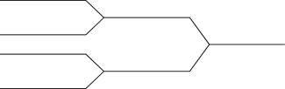
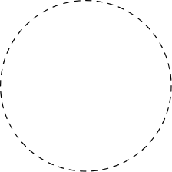
SMART INVEST
USING BLOCKCHAIN

Slide 2
Contents
Relevance of the project
Description of the project
Objective of study
Existing System and Proposed System
Modules
UI Design and Back-End Design
Screen Shots

Slide 3
Relevance of the project

Slide 4
Relevance of the project
Supply chain is always hard to manage and requires a lot of administrative machinery. However, when managed with smart contracts using blockchain, a lot of the paperwork is reduced. Also it leads to an increase in the transparency and helps to build an efficient Root of Trust. Smart-Invest is such an implementation of a supply chain management system which uses blockchain to ensure a transparent and secure transfer of product from the manufacturer to the customer via the online e-commerce websites.

Slide 5
Description of the project

Slide 6
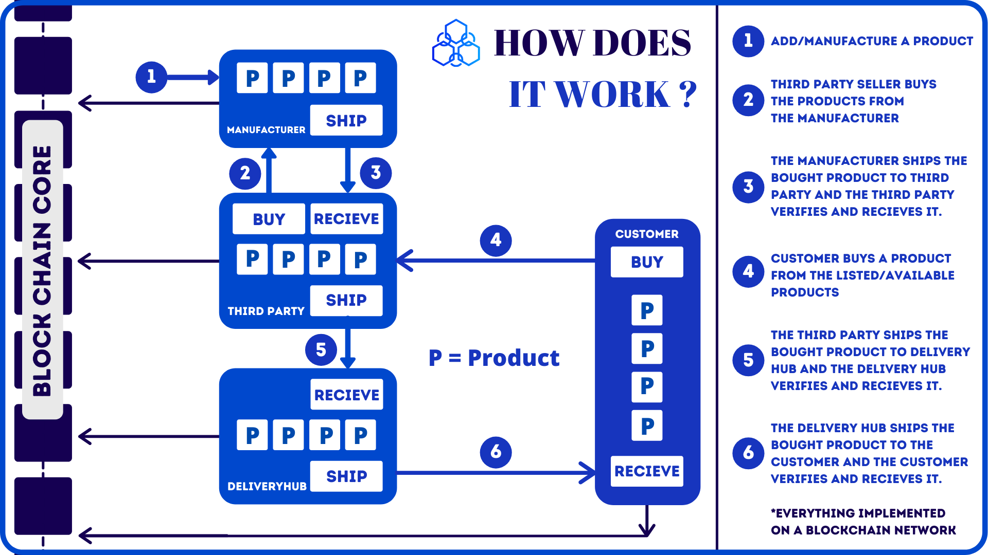
Description the project

Slide 7
How to achieve this!!!
Blockchain Technology is a technology that uses immutable ledger, it refers to any records that have the ability to remain unchanged. It cannot be altered and hence the data cannot be changed with ease, thereby making sure that the security is quite tight.
Immutability means that it is very difficult to make changes without collusion. The central idea behind the blockchain ledger is the security of data and the proof that data has not been changed or altered.
Since all the data is stored in ledger with encryption and hashing, Blockchain is a tamper-proof mechanism. So no attacker can manipulate the data. It maintains integrity.

Slide 8
Objectives of study

Slide 9
Objective of study
01
Integrating blockchain technology with the platform.
To provide better transparency and security to data.
To determine methods that could effectively manage business activities.

Slide 10
Existing System and Proposed System

Slide 11
Existing system
The Existing System involve only two entities.
They all work in different platforms.
In this system, the interaction only takes in between the buyer and seller.
No Blockchain implementation for secure transaction.

Slide 12
Proposed system
The Proposed System brings the Manufacturer, Seller, Delivery Hub and the Buyers(Customers) to a single platform.
With the implementation of blockchain, the transactions become more secure and efficient.

Slide 13
Modules

Slide 14
Modules
Assign roles and user activities
Sellers
Manufacture
Buy products from manufacturers
Receive the product from manufacturer
Ship products to delivery hub
Create a product entry
Ship the product to Sellers
View all products
Customer
Delivery Hub
Purchase product from seller
Receive product from delivery hub
View all your products
Receive product from seller
Ship the product to customer

Slide 15
Explorer activity and invoice generation
Detailed view of a product lifecycle
Invoice generation

Slide 16
UI and Back-End design

Slide 17
UI and Back-End
HTML & CSS
JavaScript
The Hypertext Markup Language or HTML is the standard markup language for documents designed to be displayed in a web browser. It can be assisted by technologies such as Cascading Style Sheets (CSS) and scripting languages such as JavaScript.
Metamask
JavaScript is often abbreviated JS, is a programming language that is one of the core technologies of the World Wide Web, alongside HTML and CSS. Over 97% of websites use JavaScript on the client side for web page behavior, often incorporating third-party libraries All major web browsers have a dedicated JavaScript engine to execute the code on users' devices.
MetaMask provides the simplest yet most secure way to connect to blockchain-based applications. You are always in control when interacting on the new decentralized web.
Solidity
Solidity is an object-oriented, high-level language for implementing smart contracts. Smart contracts are programs which govern the behavior of accounts within the Ethereum state.
Solidity is a curly-bracket language designed to target the Ethereum Virtual Machine (EVM). It is influenced by C++, Python and JavaScript. You can find more details about which languages Solidity has been inspired by in the language influences section.
Ganache
Ganache is a personal blockchain for rapid Ethereum and Corda distributed application development. You can use Ganache across the entire development cycle; enabling you to develop, deploy, and test your dApps in a safe and deterministic environment.

Slide 18
Screen Shots

Slide 19
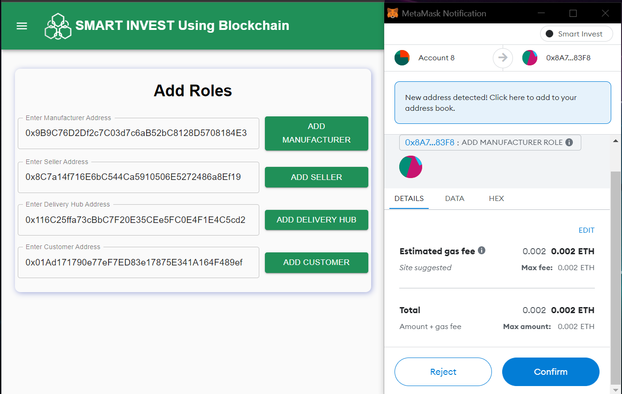
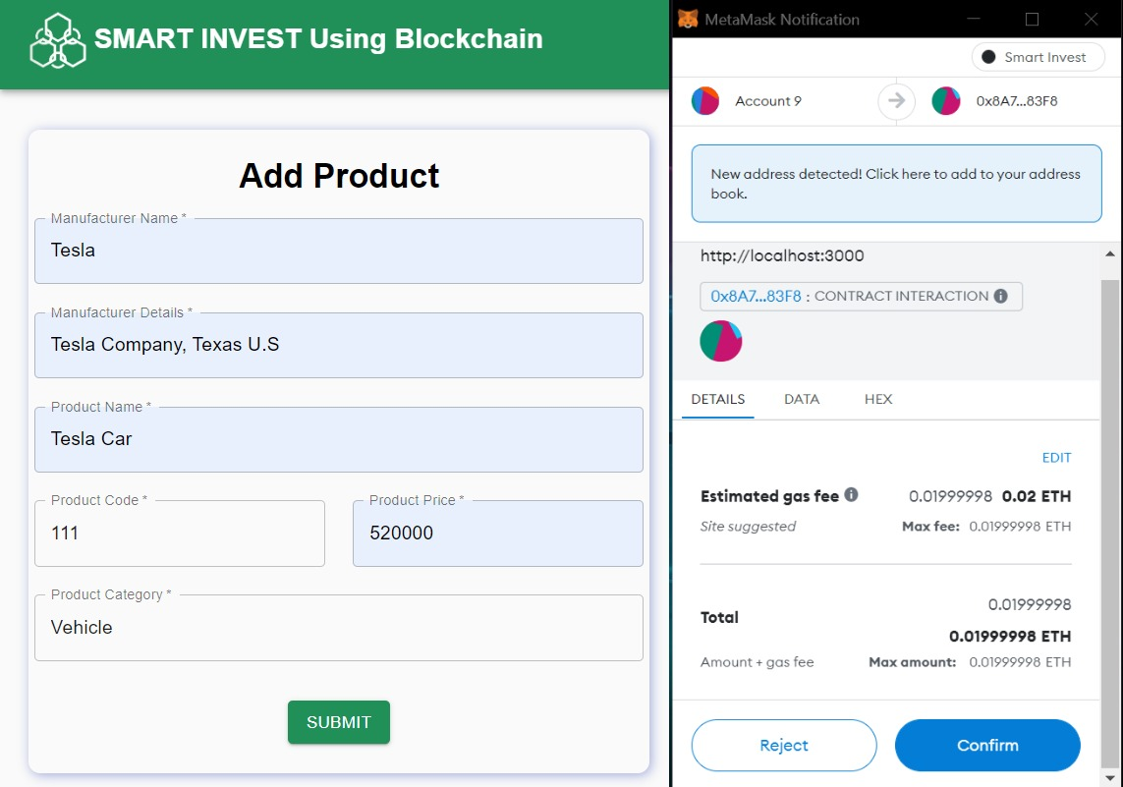

Slide 20
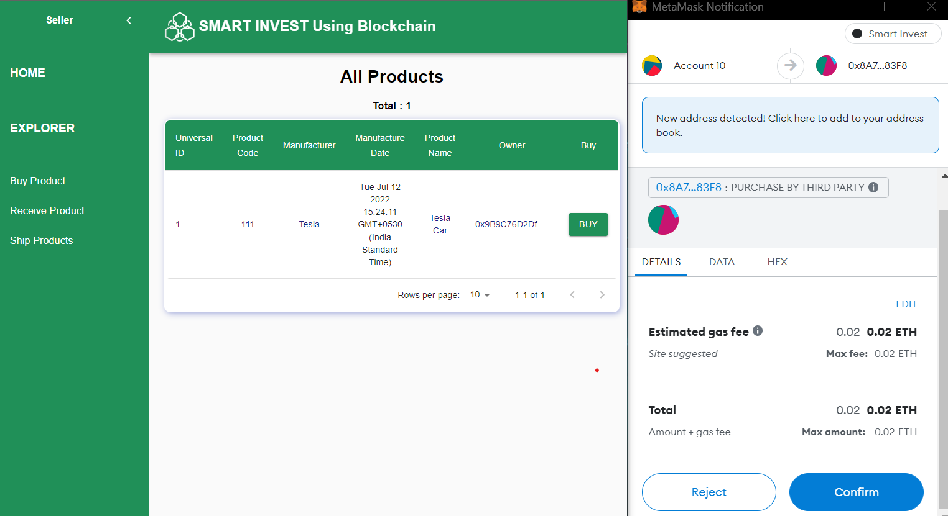
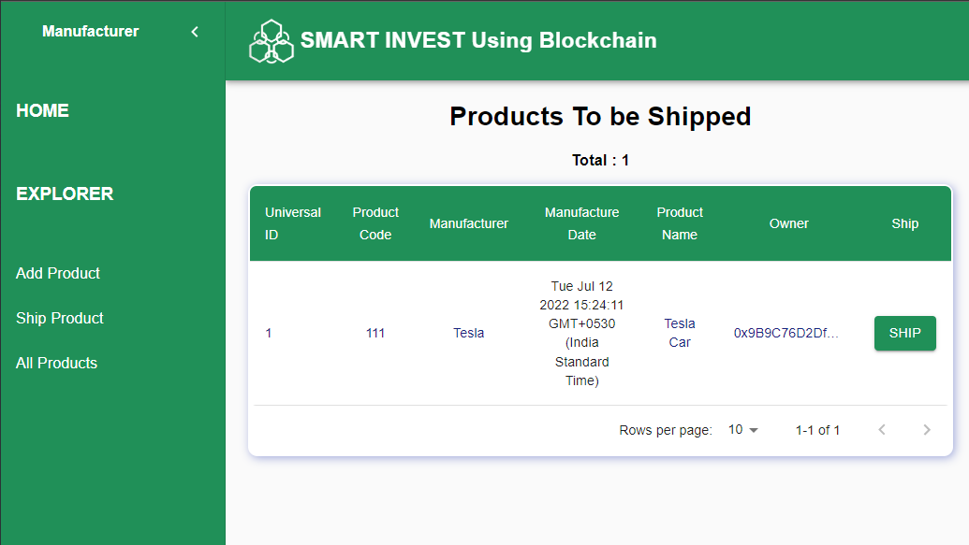

Slide 21
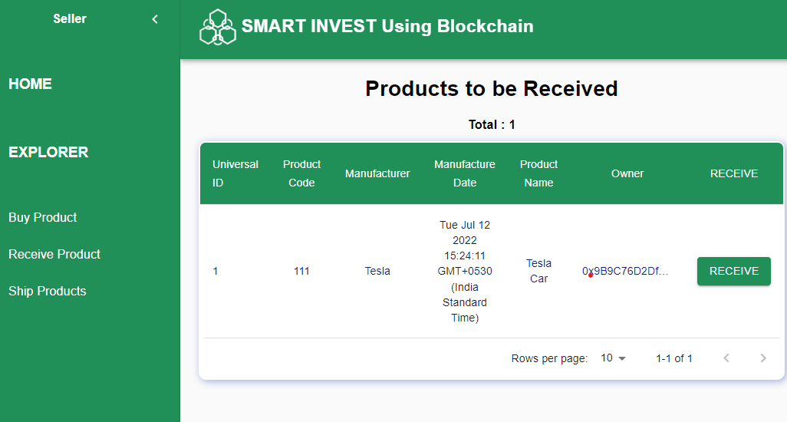


Slide 22
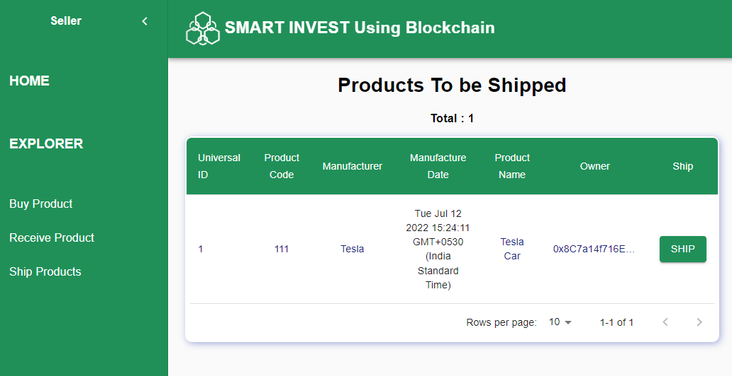
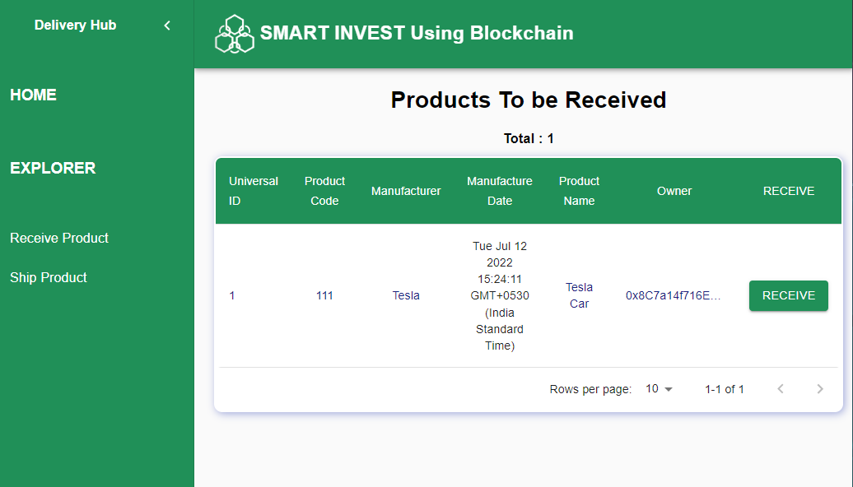

Slide 23
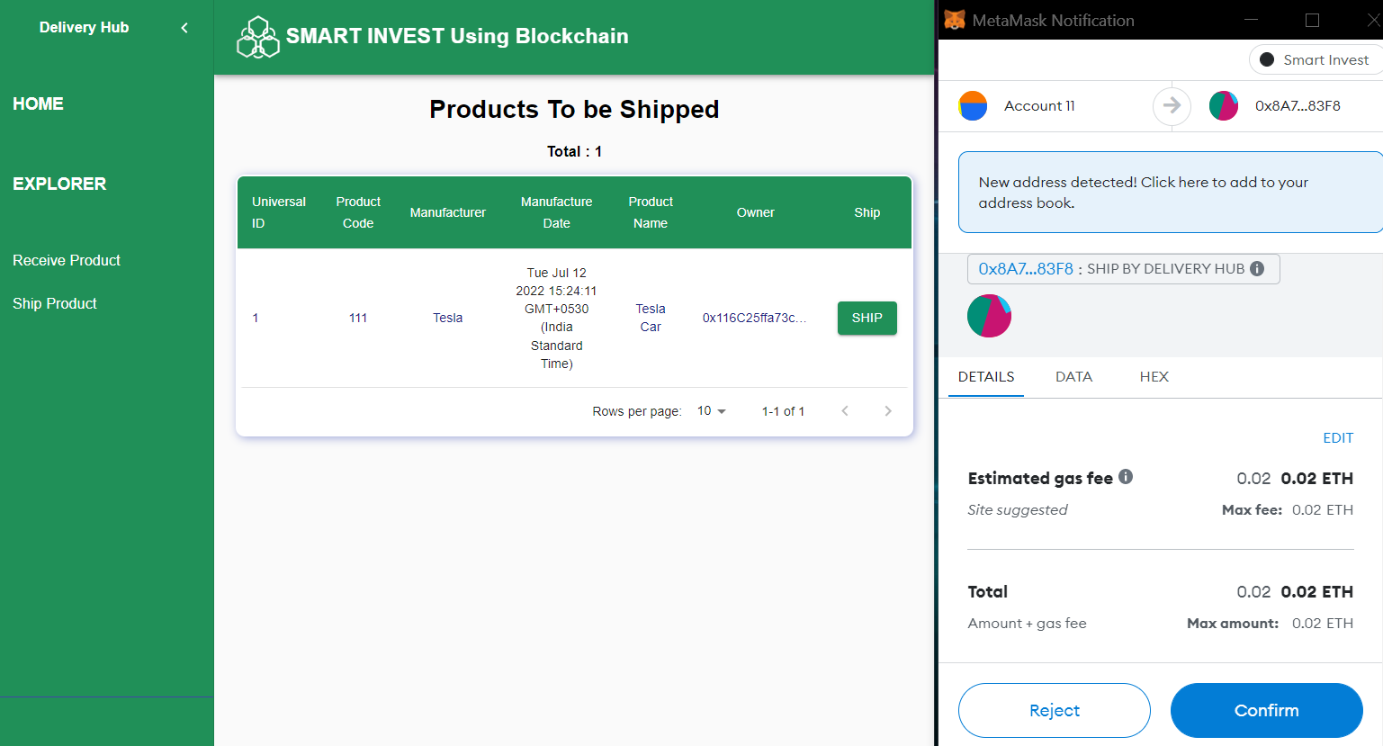
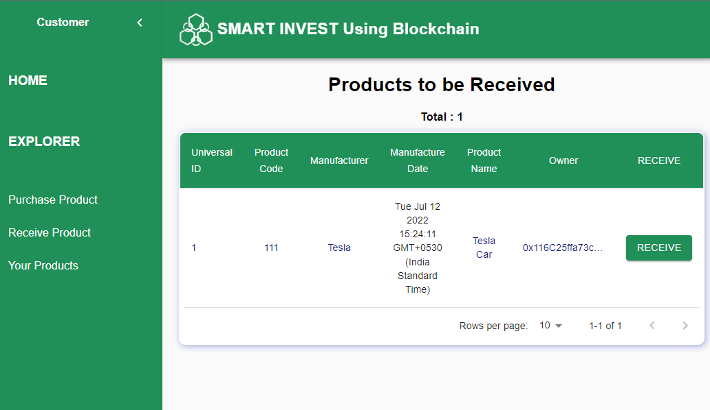

Slide 24
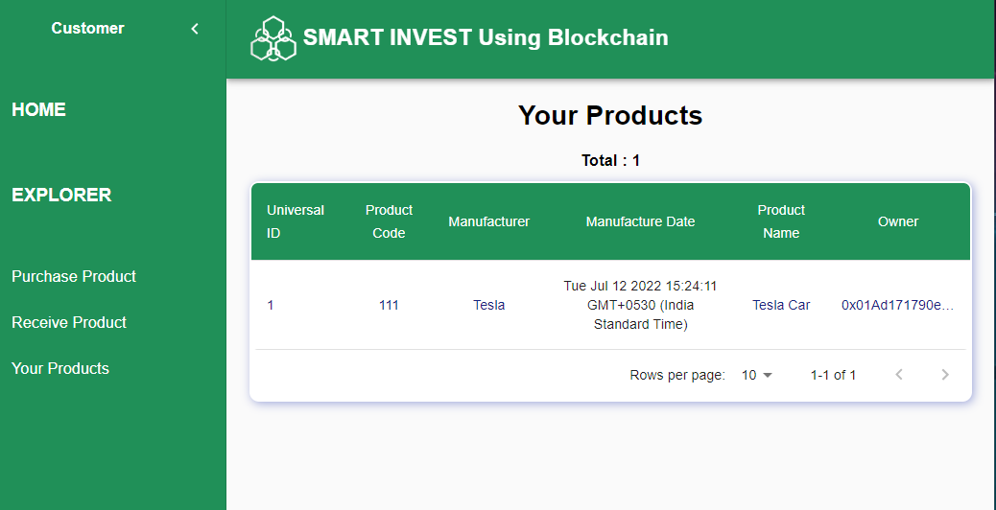
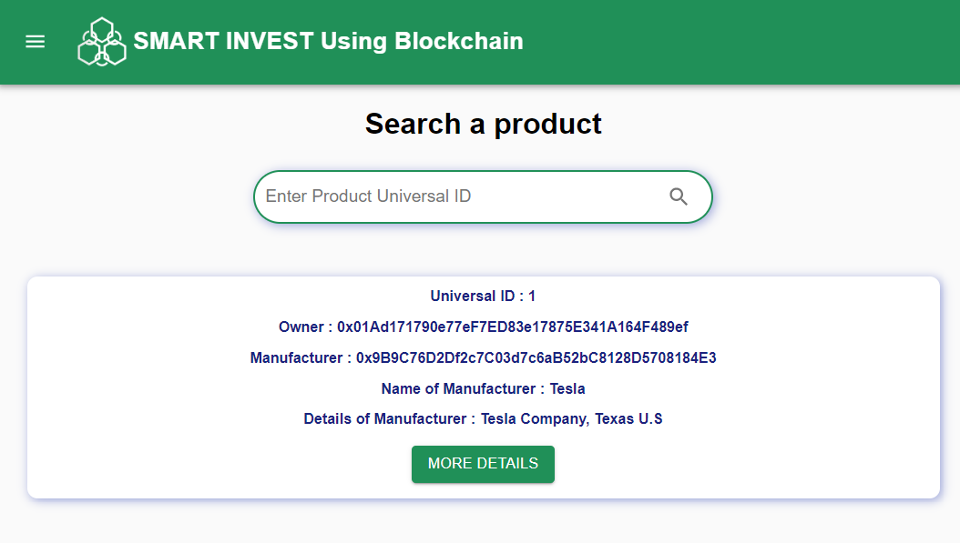

Slide 25
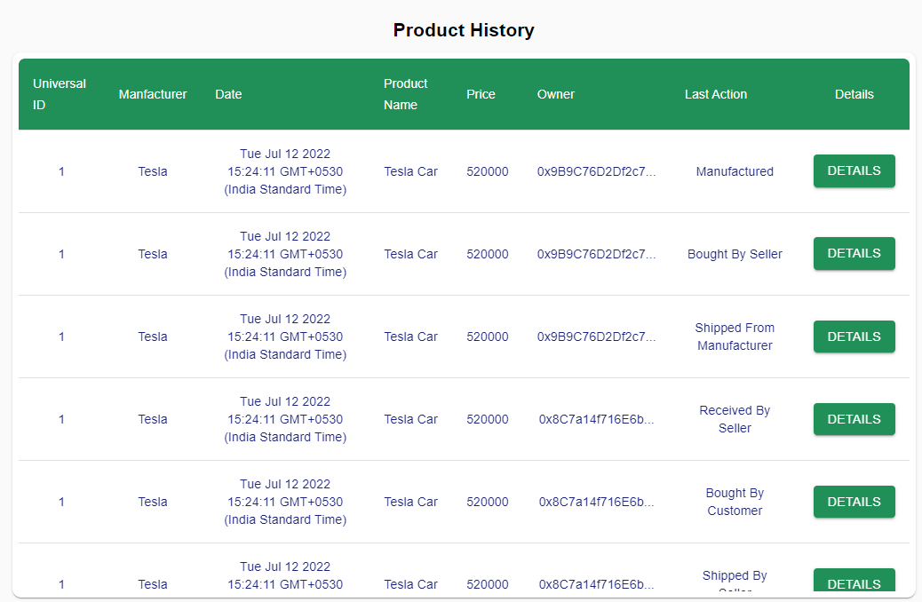
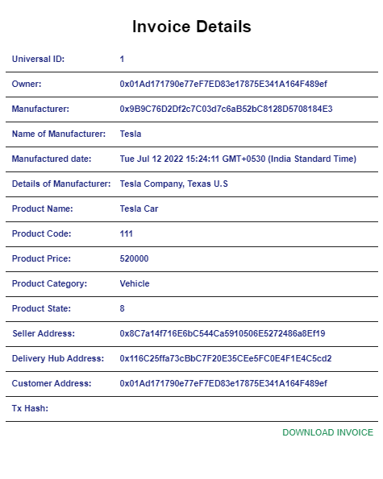

Slide 26
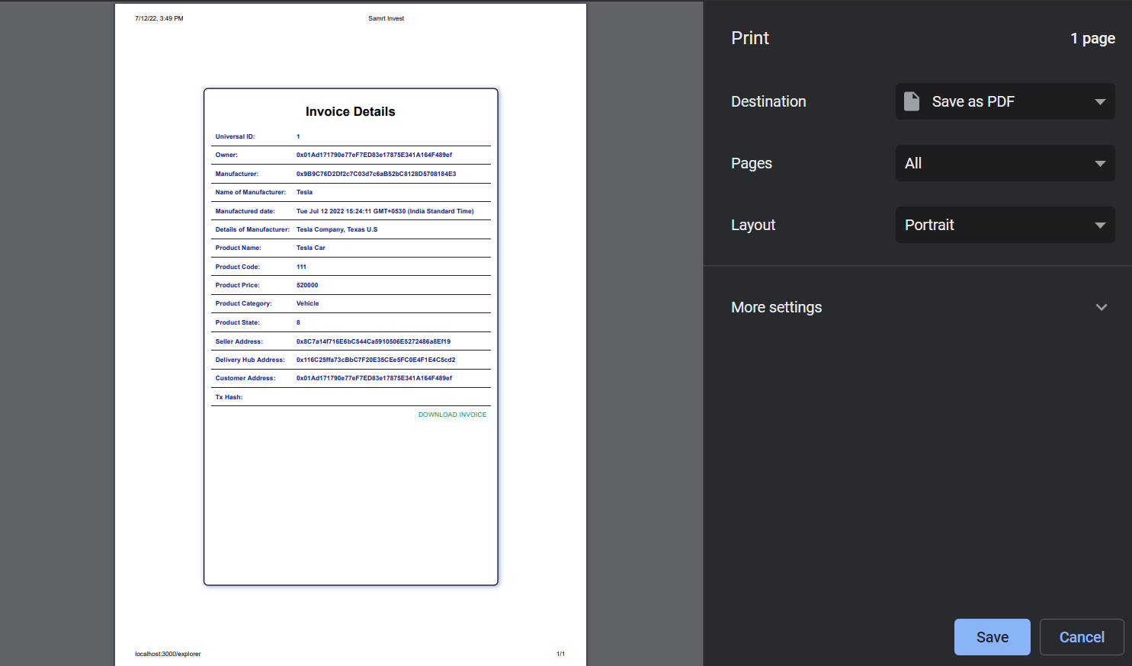

Slide 27
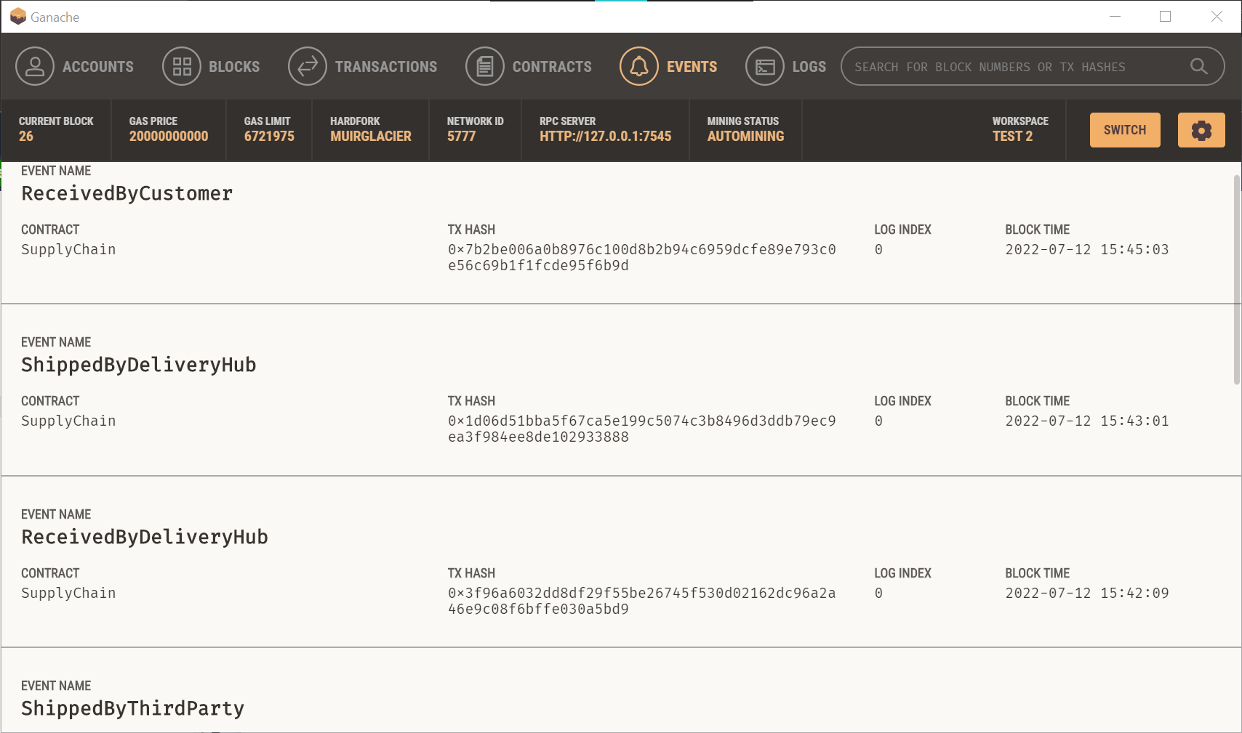

Slide 28
THANK YOU

